Slide 1
Module 9
Data presentation

Slide 2
Lecture objectives
Identify the elements of, and know how to build effective Tables
Recognize the importance of transparent data presentation
Recognize the elements of effective visual/graphical data presentation

Slide 3
Data presentation (tables and figures)
Many readers of research article actually read:
Only the title + abstract
Only the title + abstract + figures, maybe glance at the tables
Some may read
The title + abstract + figures + tables + conclusion (maybe the discussion)
Few read the whole thing
Tables and figures should:
describe the study sample (if applicable) and convey the main study findings in a manner that is easily understandable
stand alone → reader should not be required to read the main text to understand
be simple, informative, and transparent
respect the journal’s format (if applicable)

Slide 4
Tables
Usually summarize the study sample or the results (e.g. demographic tables, descriptive stats of results)
Title of table is shown ABOVE the table and briefly describes its content
Avoid abbreviations whenever possible as these will need to be defined in the footnote
Justify the first column to the left, usually justify right or centered for other columns
May use horizontal lines to define sections but vertical ones should not be used
Always indicate “n” and units
Present values with appropriate precision level (not 2.654328)
For details explained in footnote, use subscript symbols (*, #, ^, +, etc… or a, b, c, d)
Present data based on whether they are descriptive (e.g. mean ± SD or median [IQR] (range) based on their distribution, or used to infer statistics, (e.g. mean ± SEM, effect estimate with 95% CI), or median [IQR]
Common mistake: p < 1.0 x 10⁻¹²

Slide 5
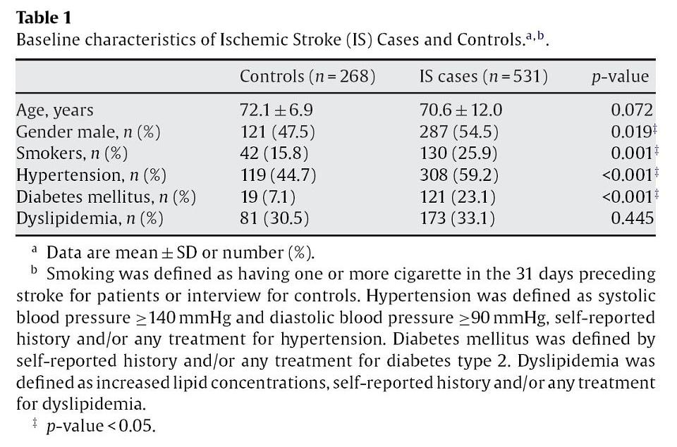
Tables − examples
Should probably be sex
Really needed?

Slide 6
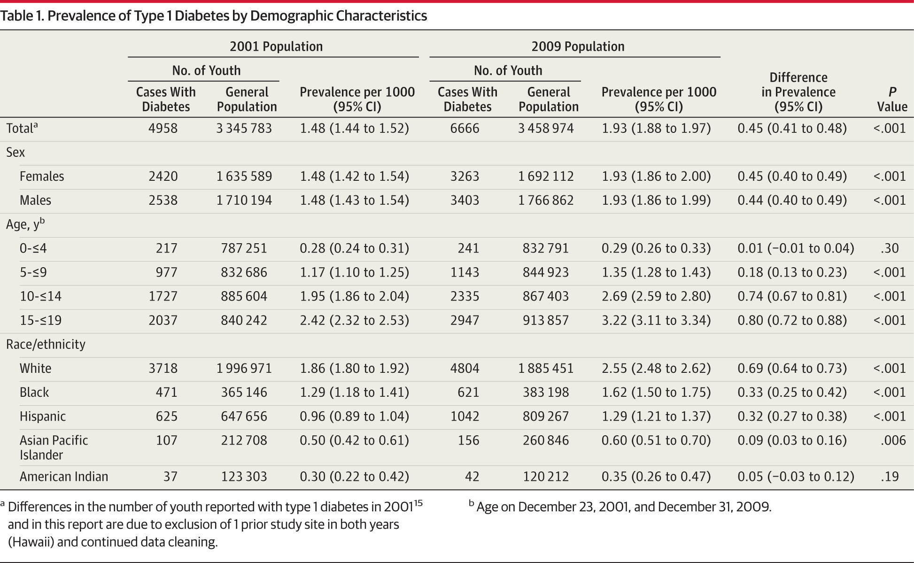
Tables − examples
Dabelea D et al. JAMA. 2014;311(17):1778

Slide 7

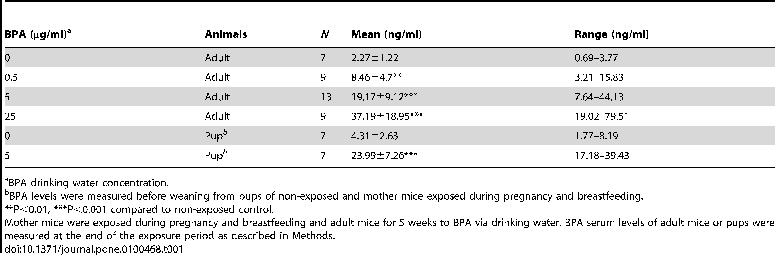
Tables − examples
Bisphenol A (BPA)
mouse
SD or SEM?
Table 1: BPA levels measured in serum.
Real
p values
mother’s exposure
Are those controls animals we don’t see data for or are they the n=7 with BPA 0 μg/ml?

Slide 8
Tables − examples
how could you improve this Table?

Slide 9
Tables − examples
A table accompanying a multivariable analysis could look like this
OR = odds ratio

Slide 10
Graphs
Classical types of Graphs:
Correlations (Pearson’s, Spearman’s)
Groups (comparing means, variance, ranks)
Frequencies (comparing proportions)
Forest plots (describing the size of independent effects)
Longitudinal studies
Survival plots
GRAPHS SHOULD BE SELF-EXPLANATORY
Graphs used in oral presentation and in manuscript may differ slightly

Slide 11
Graphs - Correlations
Choose the proper correlation based on the data
Do not draw a regression line when showing Spearman’s correlation
Indicate r or rho as appropriate (can be on the figure or in the figure legend)
Indicate real p value rather than * or p<0.05
Consider using colour or symbols to provide additional information
Start axes at zero, if not, consider breaking the axis
Title always goes BELOW the graph
Typically, there should be a short title, followed by a more detailed figure legend (journal-dependent)

Slide 12
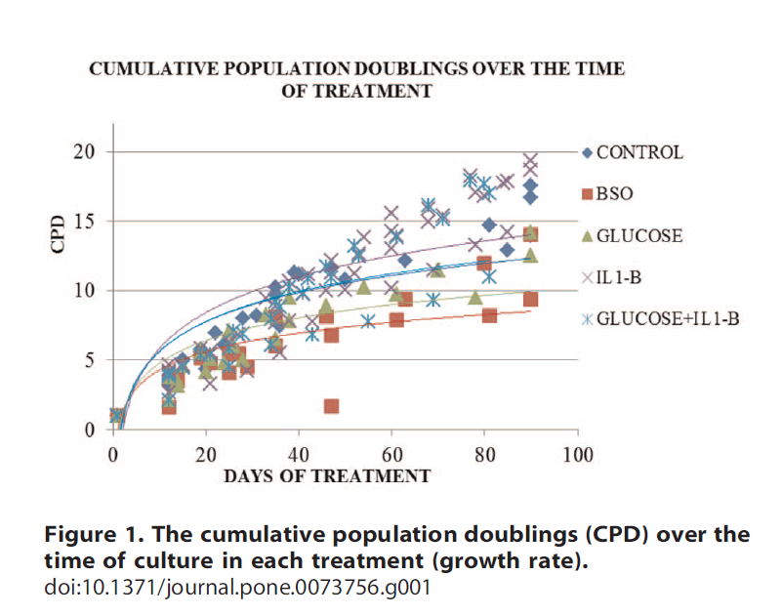
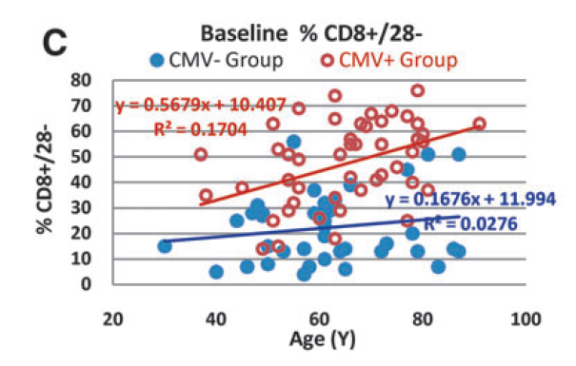
Graphs – bad choices

Slide 13
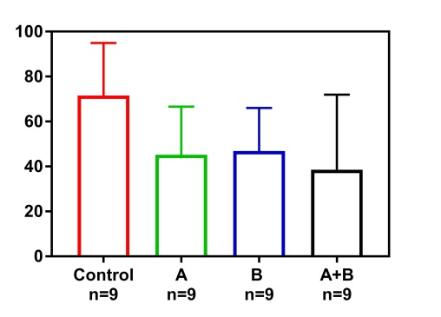
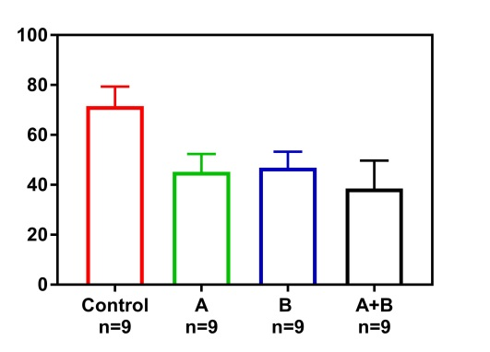
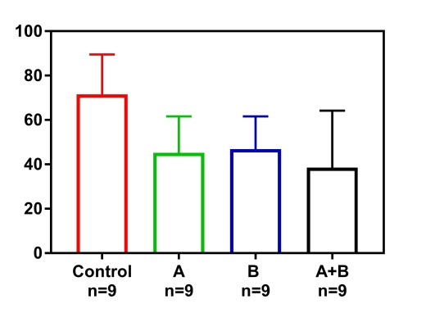
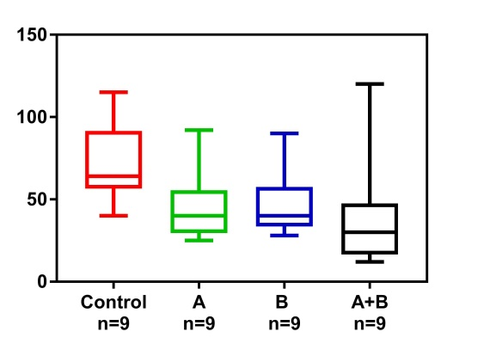
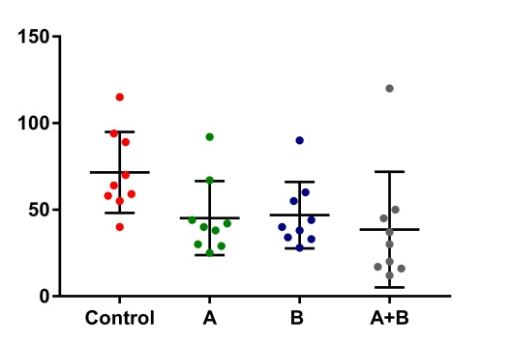
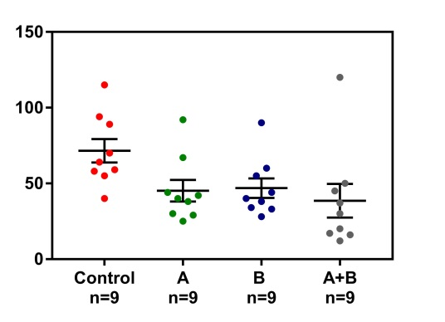
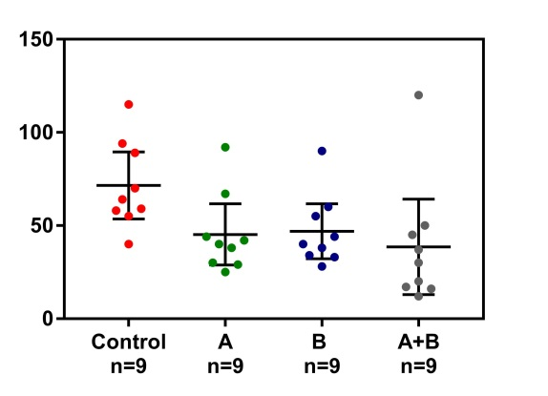
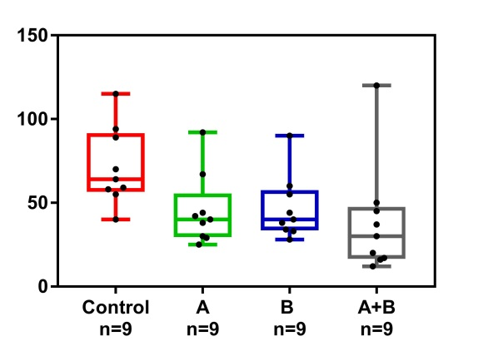
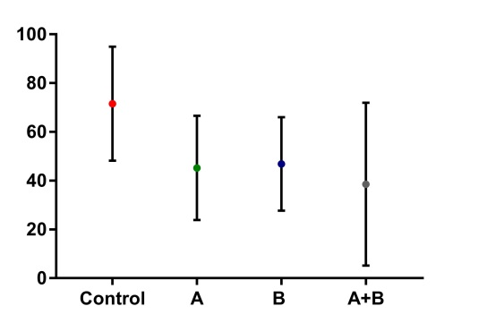
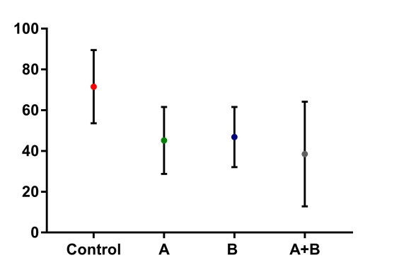
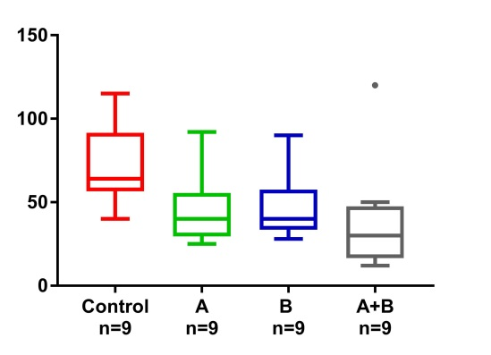
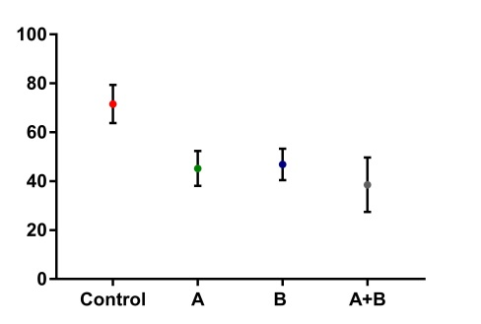
Which graph would you favour if you are trying to infer differences?
A
Mean, SD
B
Mean, SEM
C
Mean, 95% CI
D
Median, IQR, range
E
F
G
H
I
J
K
L

Slide 14
Which graph would you favour if you are trying to infer differences?
A
Mean, SD
B
Mean, SEM
C
Mean, 95% CI
D
Median, IQR, range
E
F
G
H
I
J
K
L

Slide 15
Which graph would you favour if you are trying to infer differences?
A
Mean, SD
B
Mean, SEM
C
Mean, 95% CI
D
Median, IQR, range
E
F
G
H
I
J
K
L
Orange would be OK if data were normally distributed

Slide 16
Graphs - Groups
Favour dot or scatter plot (if n not too large) or boxplot (if n is large)
= most transparent and provides more information to the reader
Bar graphs should be reserved for count data
Whenever possible, shows ALL the data, it reveals distribution, spread, variance, and outliers
Consider adding information through colour, shape, or size of dots
Start axes at zero, if not, break the axis
Show bars for variance/distribution (mean + SEM or 95%CI or median + IQR)
Show real p values rather than stars
Clearly indicate what groups are compared (usually line between them)
Indicate size of “n” if not obvious
If doing too many comparisons, use correction (e.g., Tukey)
Avoid abbreviations as they will need to be defined in the footnote
Avoid slanted label if possible
In Figure legend, indicate what the error bars are, the sample size (if not already on figure), and/or the number and type of replicate, may want to also indicate the statistical test used

Slide 17
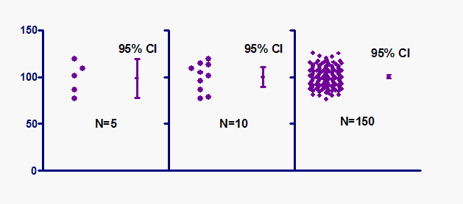
Graphs
The effect of the sample size on the variance is almost completely lost on the reader if you use bar graphs and do not indicate the n on the graph
Is the error bar large because the variance is large or because the sample size is small?
GraphPad tutorial
Mean and SD
Mean and SEM
Mean and 95% CI

Slide 18
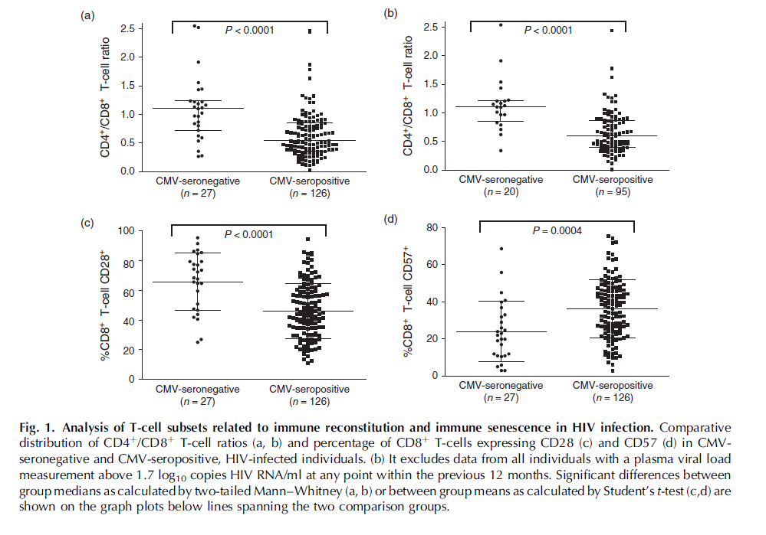
Graphs
Could consider boxplot or violin plot
P < 0.0001

Slide 19
Graphs
Can use two axes
Refrain from drawing solid lines between points if they are not linking the same cells, animals, or humans

Slide 20
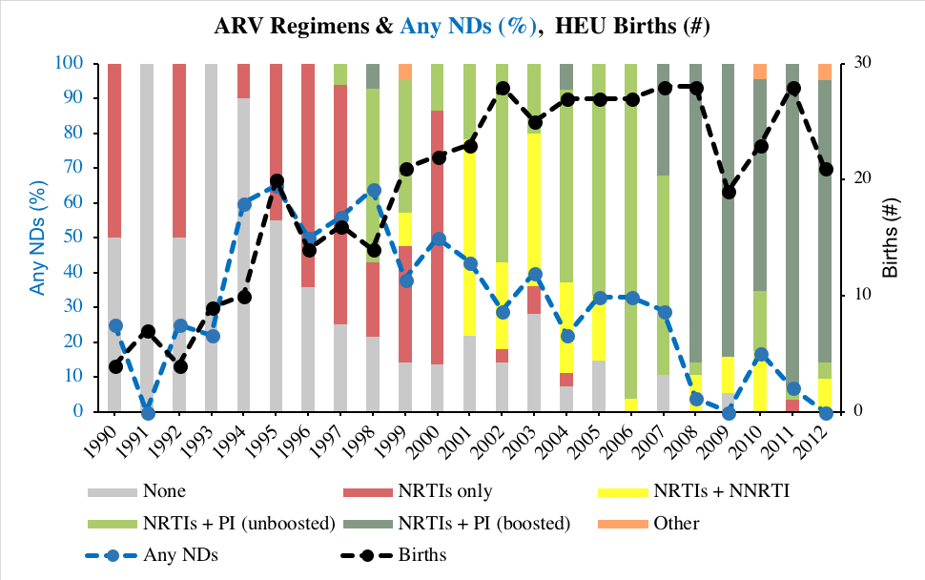
Graphs
Too much?

Slide 21
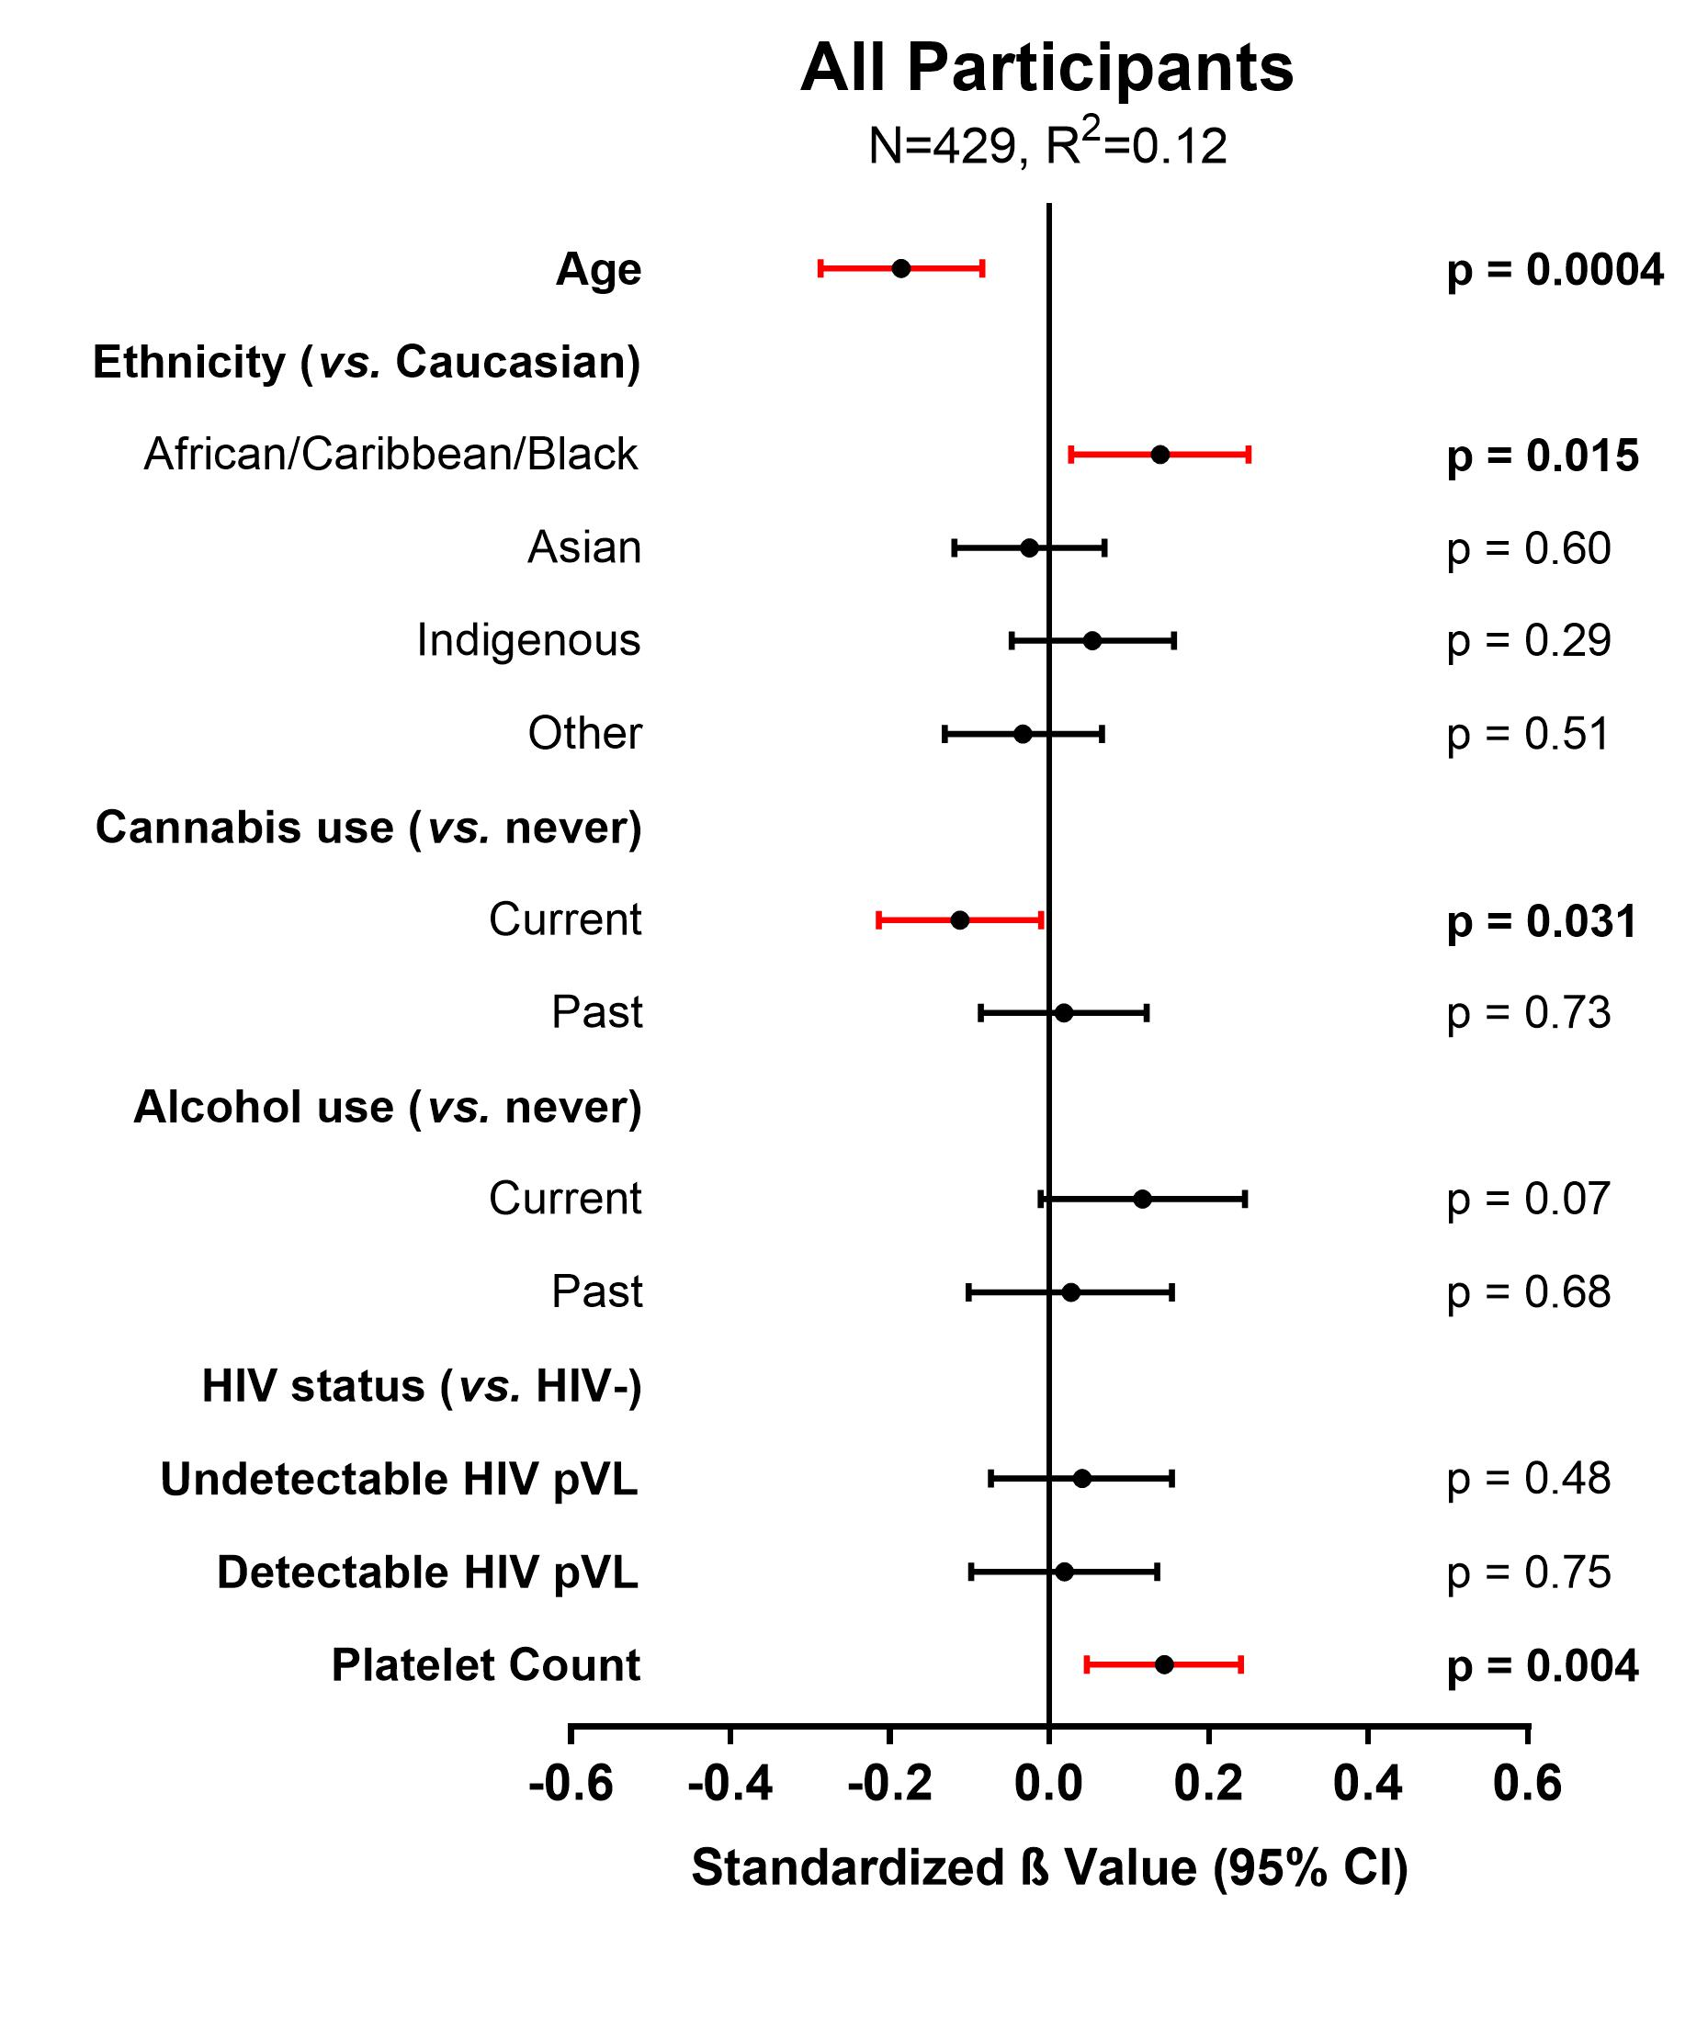
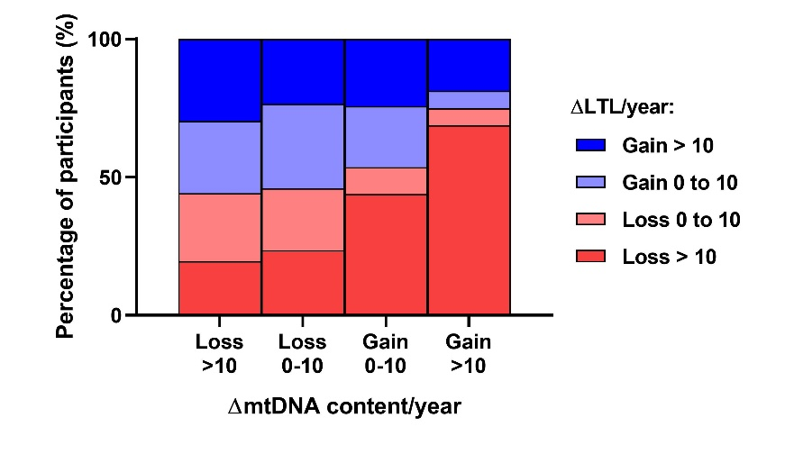
Graphs
Forest plot

Slide 22
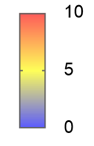
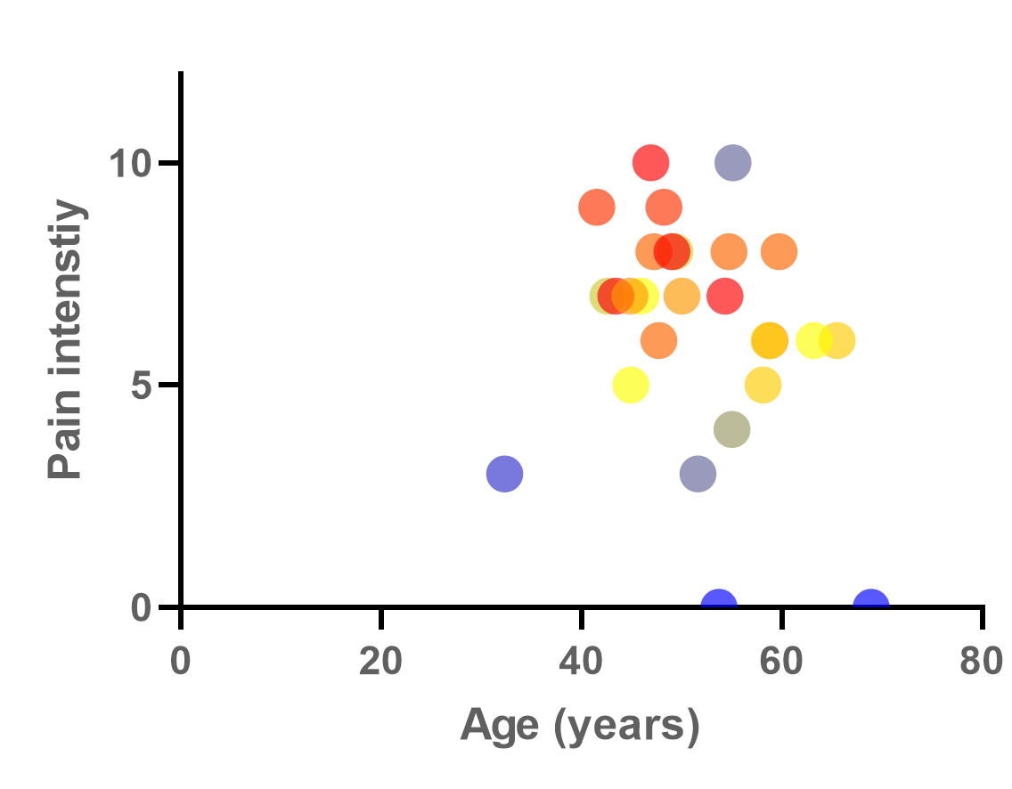
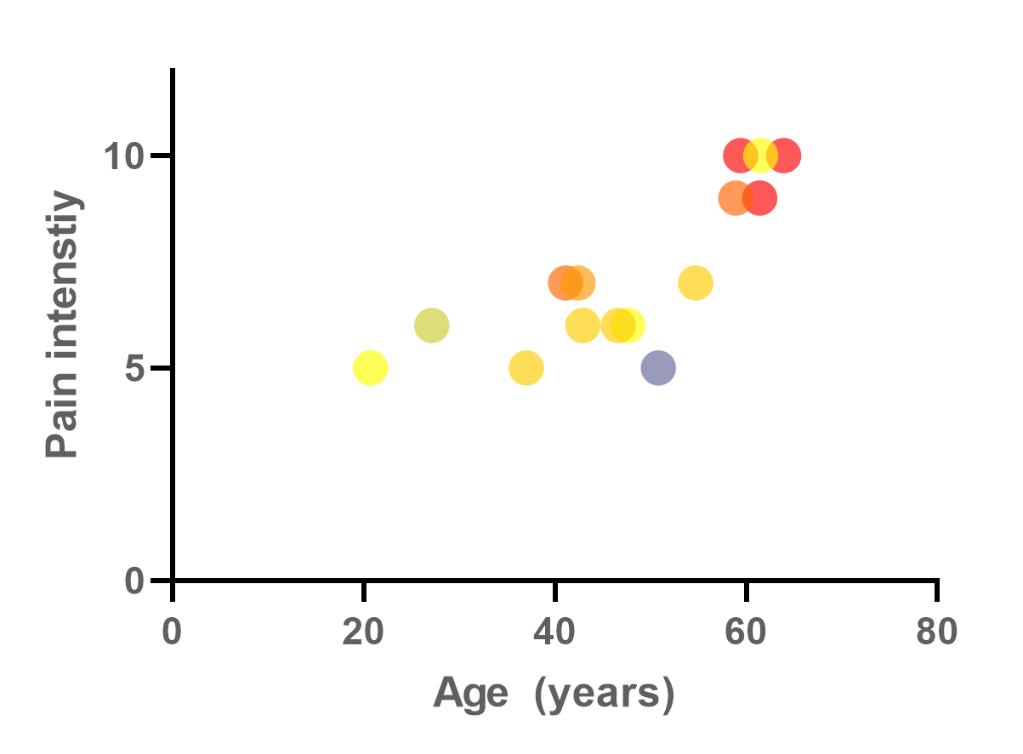
Graphs
The primary goal of a graph is not always to support statistics, it can be used to simply describe and visualize data. It can use more than two dimensions
Interference with general activity
Women living with HIV
Controls

Slide 23
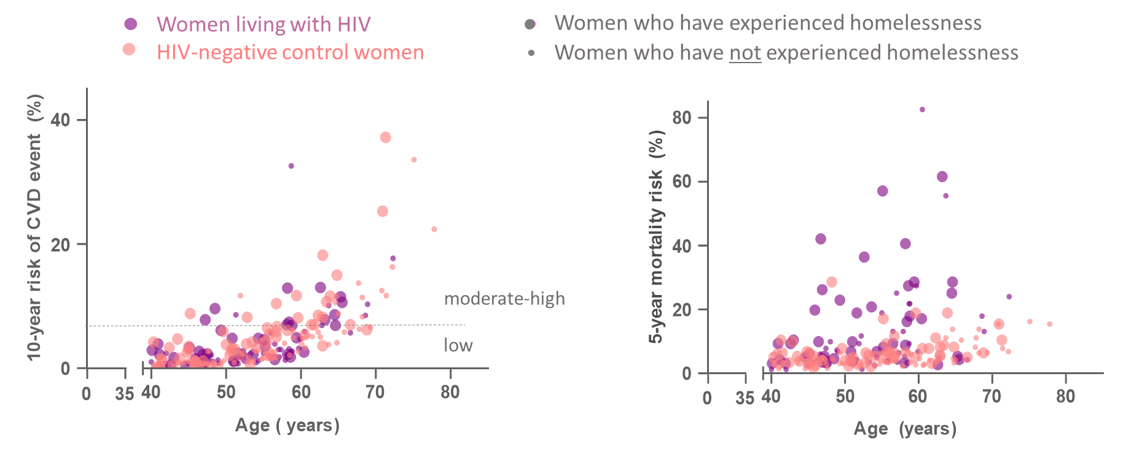
Graphs
 | Women living with HIV (n= 88) | HIV-negative Controls (n = 124) | P value
10-year cardiovascular event risk (ASCVD), median [IQR] | 2.4 [1.2-5.7] % | 3.4 [1.2-6.4] % | 0.3
5-year all-cause mortality risk (VACS 2.0), median [IQR] | 6.8 [3.9-18.7] % | 5.0 [3.3-6.8] % | <0.001

Slide 24
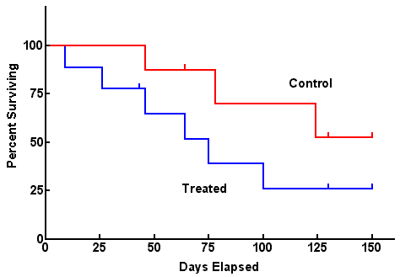
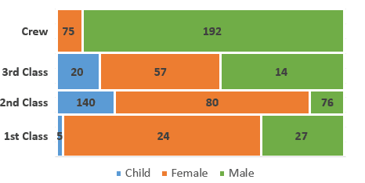
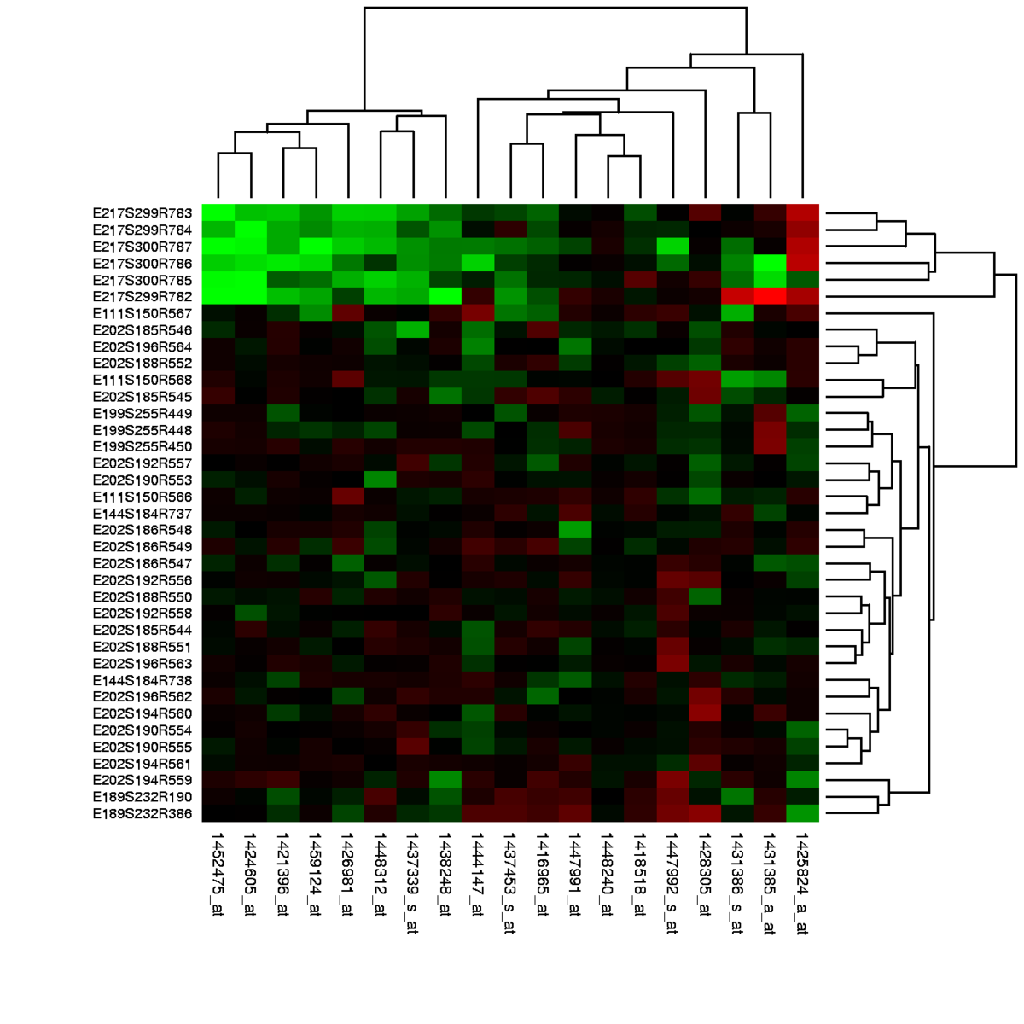
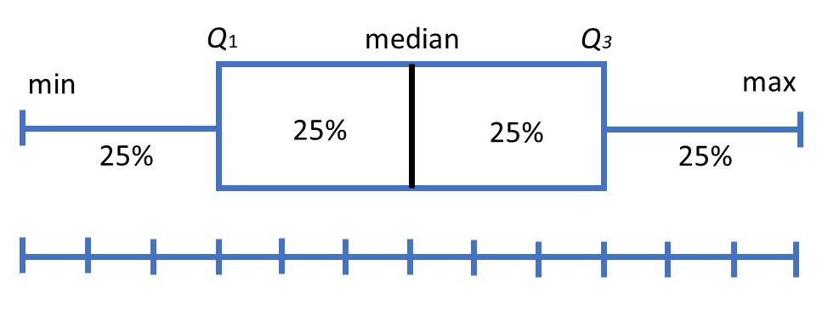
Graphs
Mosaic plot
Survival plot
Survivors of Titanic
Heat maps
Box plot (can be vertical or horizontal, can show data points or not)

Slide 25
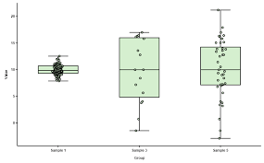
Graphs
The graphs generated as output from statistical software or R or python are useful when in work mode but their default output format is usually not suitable for publication
- Labels are often too close to axes, too small, or reflect the variable’s “code” in R
- Font size are often inadequate
- Colours, background, grids are often unnecessary
- Not what top journals are looking for
may hinder getting you in a top journal
But R or python output can be modified
Generally, GraphPad Prism is convenient for simple figures
Several specialized software exists for more advanced data presentation, 3D plots, volcano plots, bubble plots, etc.

Slide 26
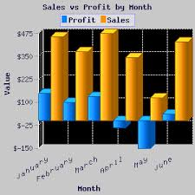
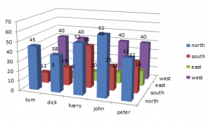
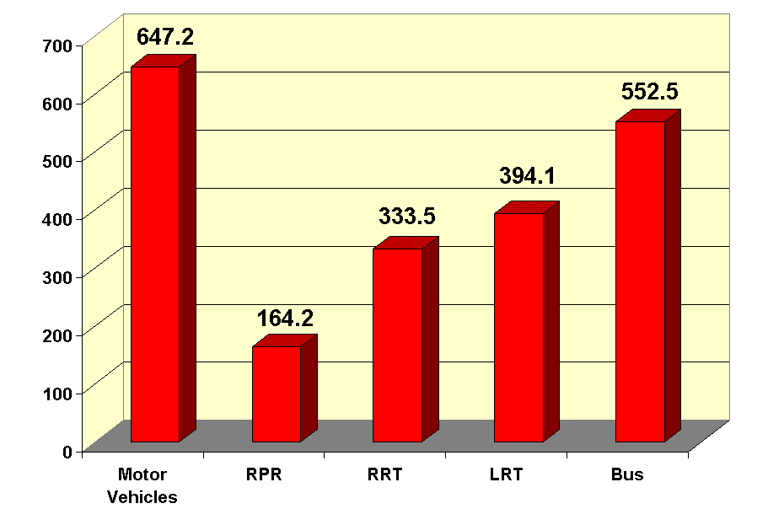
Graphs − stay away from “fluff” − less is more

Slide 27
Other resources, readings
http://www.editage.com/insights/tips-on-effective-use-of-tables-and-figures-in-research-papers
Stephen Few. Show me the numbers – Designing tables and graphs to enlighten. 2nd Edition Analytic Press
Streit M & Gehlenborg N. Bar charts and box plots: Creating a simple yet effective plot requires an understanding of data and tasks. (2014) Nat Methods 111(2):117
Krzywinski M & Altman N. Visualizing samples with box plots (2014) Nat Methods 111(2):119
Spitzer et al. BoxPlotR: a web tool for generation of box plots (2014) Nat Methods 111(2):121
Krzywinski M & Wong B. Plotting symbols (2013) Nat Methods 110(6):451
A Short Guide to Writing about Biology (8th Edition) https://www.amazon.ca/dp/020507507X/ref=cm_sw_r_em_apa_i_f.A9AbAWPM5KW
Nature Methods blog on data visualization. http://blogs.nature.com/methagora/2013/07/data-visualization-points-of-view.html

